Slide 1
SMART KEYBOARD WITH MOUSE
ECX6595-INDIVIDUAL PROJECT TYPE B
2nd PROGRESS PRESENTATION
SUPERVISOR
MR.W.D.S.S. BANDARA
PREPARED BY – M.M.K.D. RATHNAYAKE 30767215

Slide 2
Contents
Introduction
Proposed system
Current status of the project
Future plans

Slide 3

Introduction
Human computer interface is the physical boundary contractions between the human and the input/output devices of a computer.
A mouse is a pointing device for human computer interface.
A Keyboard is the primary text input device for human computer interface.

Slide 4
Aim
To design and implement a new conceptual on hand computer key board with a mouse.
Objectives
Assign maximum number of Characters and other keys to limited number of key allocation spaces in hand’s fingers.
Detect hand movements in the free space and obtain mouse operations.
To make a Human Computer Interface Device.

Slide 5
The Proposed System
Micro
controller
Hand movement detection
Interface circuit
Key Matrix
Display
Computer

Slide 6
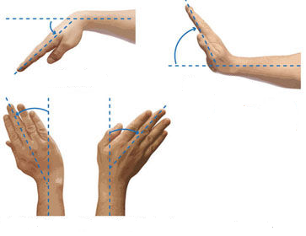
Hand Movement Detection
Possible Hand tilt movements
Pitch , the vertical hand movement (up or down)
Yaw, the Horizontal hand movement
( Right or Left)

Slide 7
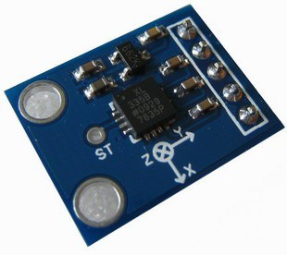
Accelerometer Sensors
The ADXL 335 is a 3 axis accelerometer with analog signal voltage outputs.
Features
3-axis sensing
Small, thin, low power package
Dimensions =15.7mm ×20.3 mm ×1.45 mm
Single-supply operation: 3 V to 5 V
Excellent temperature stability

Slide 8
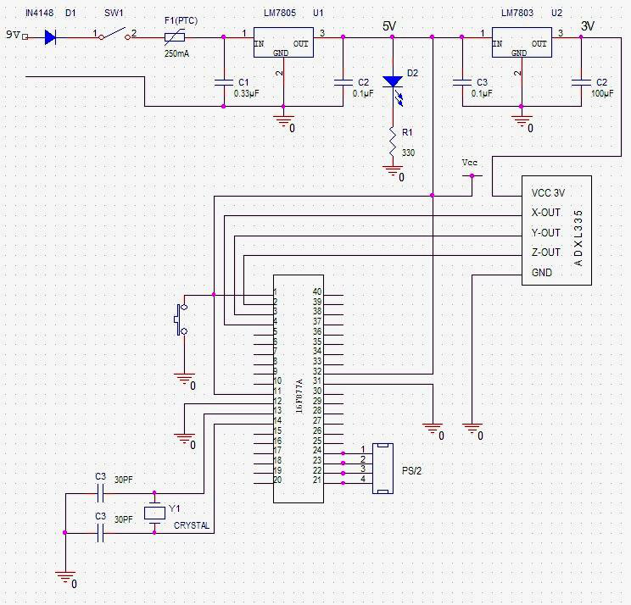
Hand Movement Detection Unit

Slide 9
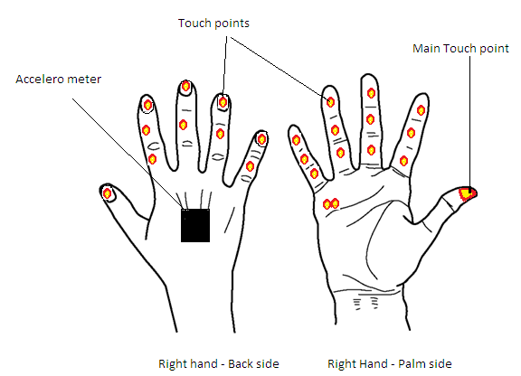
The Key Matrix
The Keys Assign on the Touch points
Alphabet ( A……..Z)
Numbers (0……...9)
Space
Backspace
ESC
Caps Lock
Enter
Brackets ( )
Delete
+ - / =
@ ? , .
Mouse Keys (Right & Left)

Slide 10
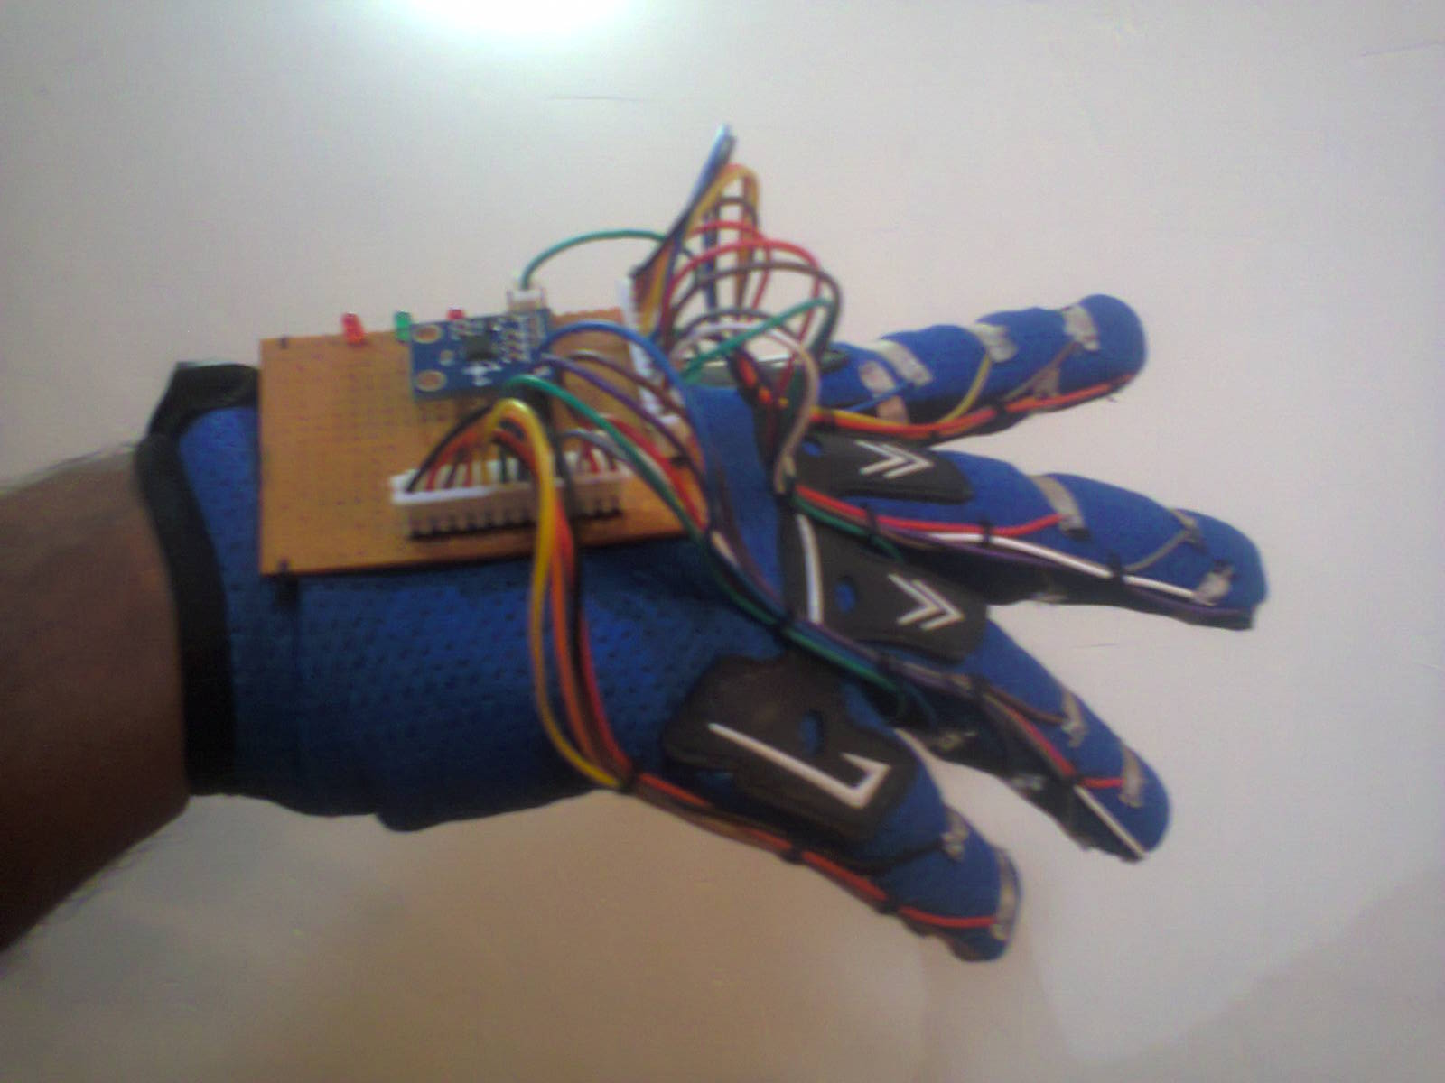
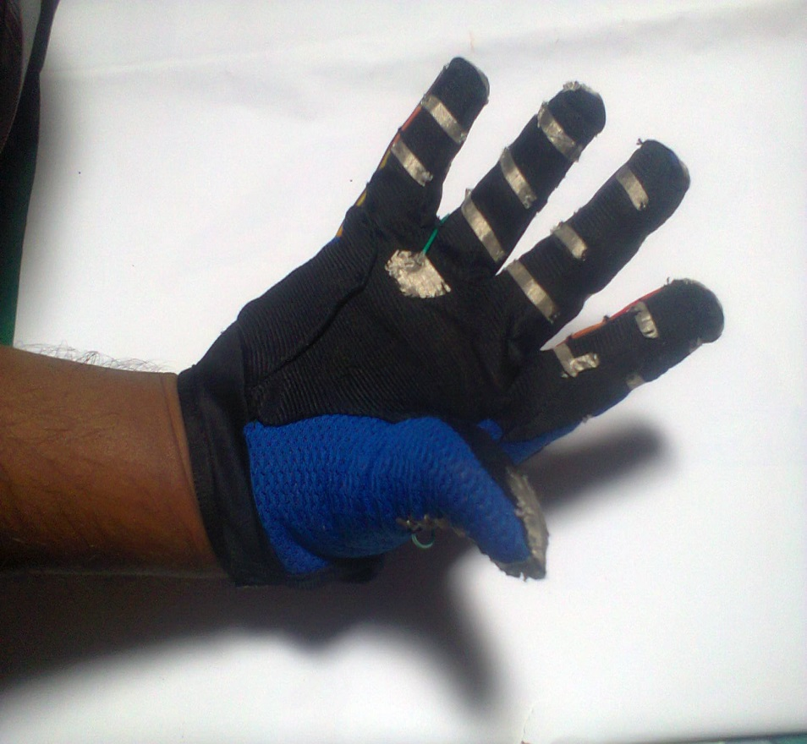
Physical view of the Developed Hand glove

Slide 11
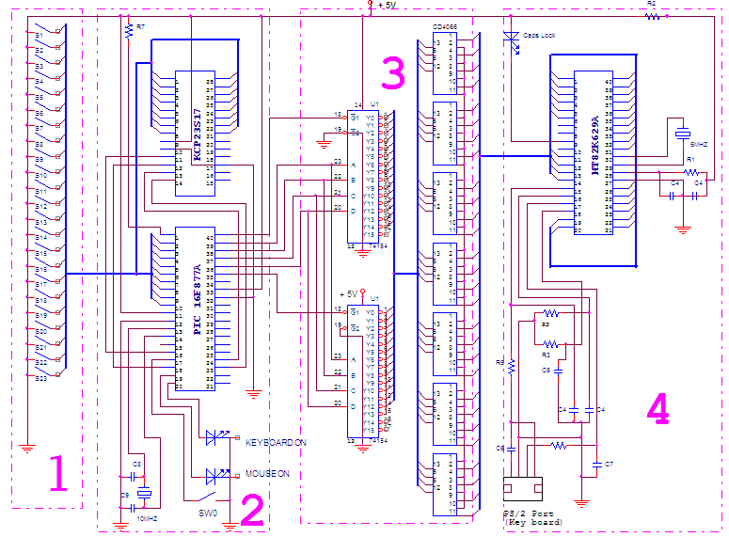
Keyboard unit

Slide 12
Functional Block Diagram of the System
Activate Mouse
Takes Accelerometer data
Convert A/D
No
If
SW0 “ON”
Start
Check mouse click statements
Decide Curser Position
`
Yes
count no. of clicks per touch point
Activate Keyboard
Process the data
Display
Activate Key encoder
Send data to PC
Decide the character or Function

Slide 13
Microcontroller Unit
Microcontroller unit [ 16F877A ]
Translate the tilt angle data to displacement of mouse cursor that is calculating new hand position from stationary point.
Communicates with operating system through the use of a device driver.
Identify the key combination of the key glove and send corresponding controlled signals to switching matrix of the key encoder.

Slide 14
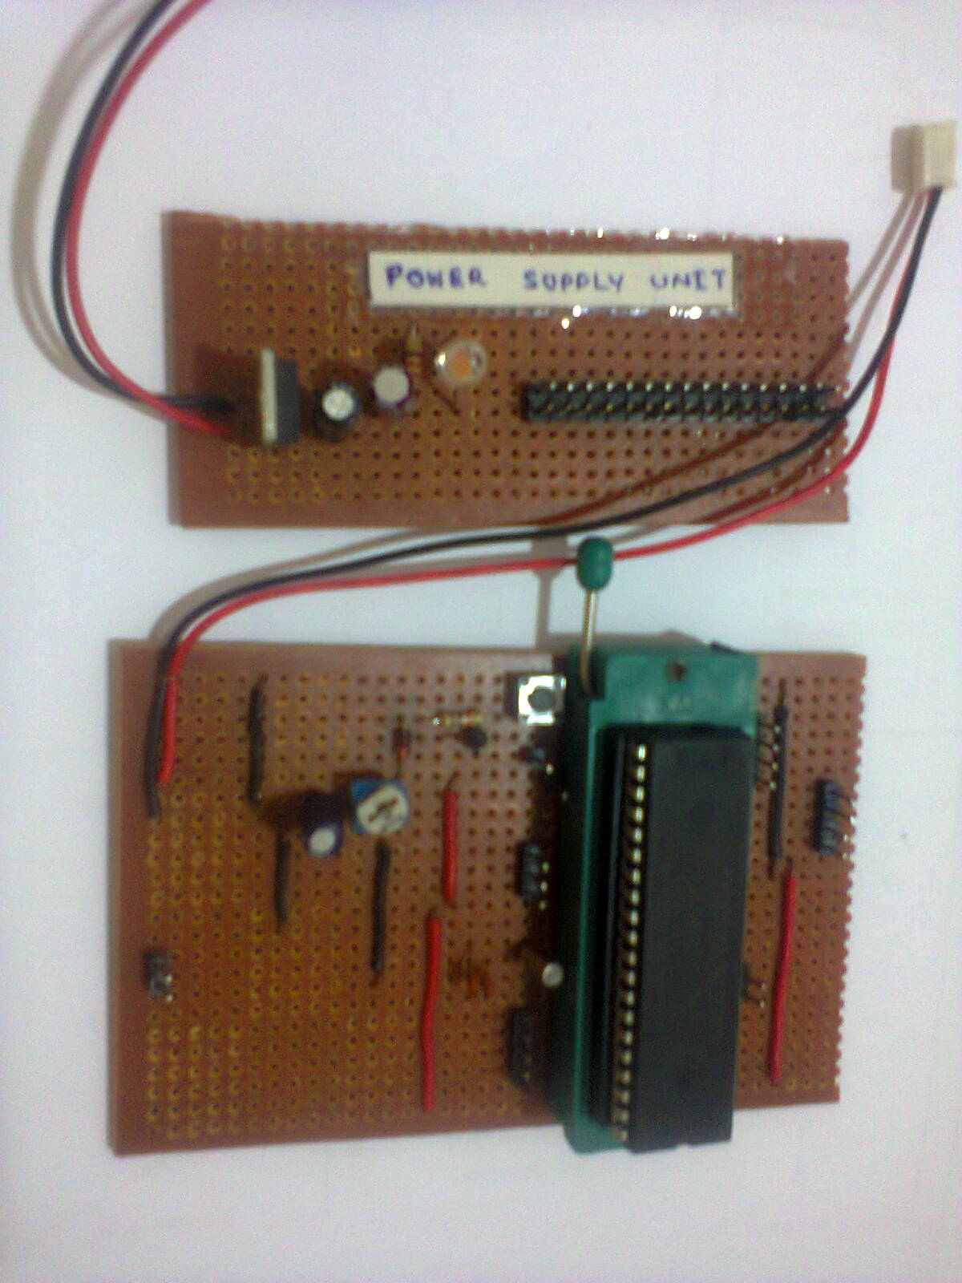
Physical view of the Developed Power supply unit and PIC basic circuit

Slide 15
Current status of the project
Designed the system and wearable module.
Purchased most of the required components for the project.
Developed the power supply circuit , PIC basic circuit & wearable module.
Tested the ADXL 335 accelerometer sensor.
Studying the programing language MIKRO C.

Slide 16
Future plans of the project
Develop all the circuits.
Develop the programming part of the project.
Testing and calibrating system.
Implement the whole system.

Slide 17
THANK YOU !

